Slide 1

Amirhossein Jani Dr. Haroon Abadi Islamic Azad University–Central Branch Aspect Oriented Software Development May-2021

Slide 2
INSTRUCTIONS FOR USE
EDIT IN GOOGLE SLIDES
Click on the button under the presentation preview that says "Use as Google Slides Theme".
You will get a copy of this document on your Google Drive and will be able to edit, add or delete slides.
You have to be signed in to your Google account.
EDIT IN POWERPOINT®
Click on the button under the presentation preview that says "Download as PowerPoint template". You will get a .pptx file that you can edit in PowerPoint.
Remember to download and install the fonts used in this presentation (you’ll find the links to the font files needed in the Presentation design slide)
More info on how to use this template at www.slidescarnival.com/help-use-presentation-template
This template is free to use under Creative Commons Attribution license. You can keep the Credits slide or mention SlidesCarnival and other resources used in a slide footer.

Slide 3
What is Aspect Oriented Software Development
1
Keywords:
Separation Of Concerns
Modularizations

Slide 4
AOSD allows multiple concerns to be expressed separately and automatically unified into working systems

Slide 5
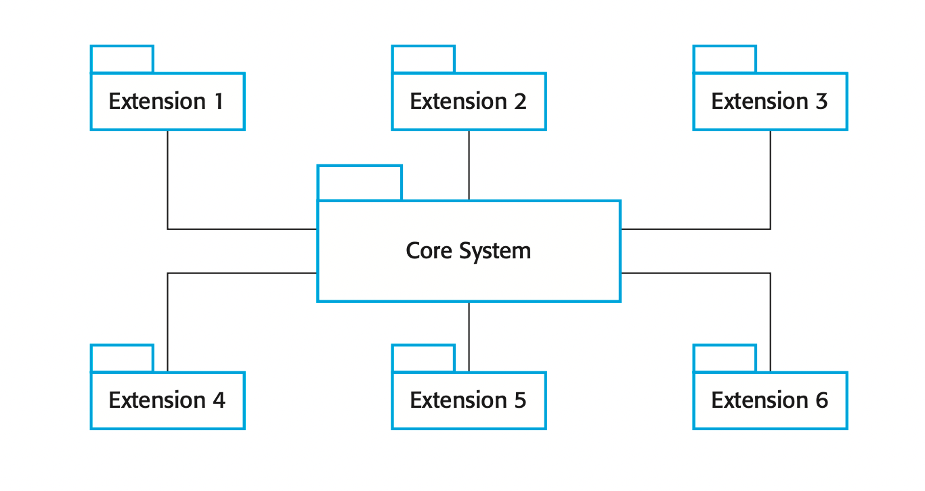
Modularizations
aspect-oriented software development (AOSD) is a software development technology that seeks new modularizations of software systems in order to isolate secondary or supporting functions from the main program's business logic

Slide 6
Aspect Oriented Software Development Introduction
AOSE is based around abstractions called aspects
important characteristic:
definition of where they should be included
implementing the cross-cutting concern
approaches to software modularization:
Subject Oriented Programming
Feature Oriented Programming
Adaptive Programming
Gregor Kiczales and Palo Alto Research Center later developed AspectJ framework which main concern is aop

Slide 7
Cross Cutting Problems
By representing cross-cutting concerns as aspects, these concerns can be understood, reused, and modified independently, without regard for where the code is used.
OR
are aspects of the program that affects other concerns

Slide 8
Separation of concerns
2

